Slide 1
Marketing Campaign Analysis Project
Insights and Recommendations for Optimizing Campaign Effectiveness at
MarketWave Superstore
Presented by: Katherine David

Slide 2
Introduction
Objective: Enhance marketing strategies to maximize profitability and customer engagement.
Scope: Analyzing customer behavior and campaign performance metrics to derive actionable insights.

Slide 3
Data Overview
Dataset Description:
- The dataset includes various customer demographics, purchasing behaviors, and responses to marketing campaigns.
Key columns:
- AcceptedCmp1-5: Indicates whether the customer accepted the respective campaign offer.
- Response: Overall response to the marketing campaigns.
- Education: Customer education levels.
- Marital Status: Customer marital status.
- Income: Customer income levels.
- NumWebPurchases: Number of web purchases made by the customer.
Data Source: kaggle.com

Slide 4
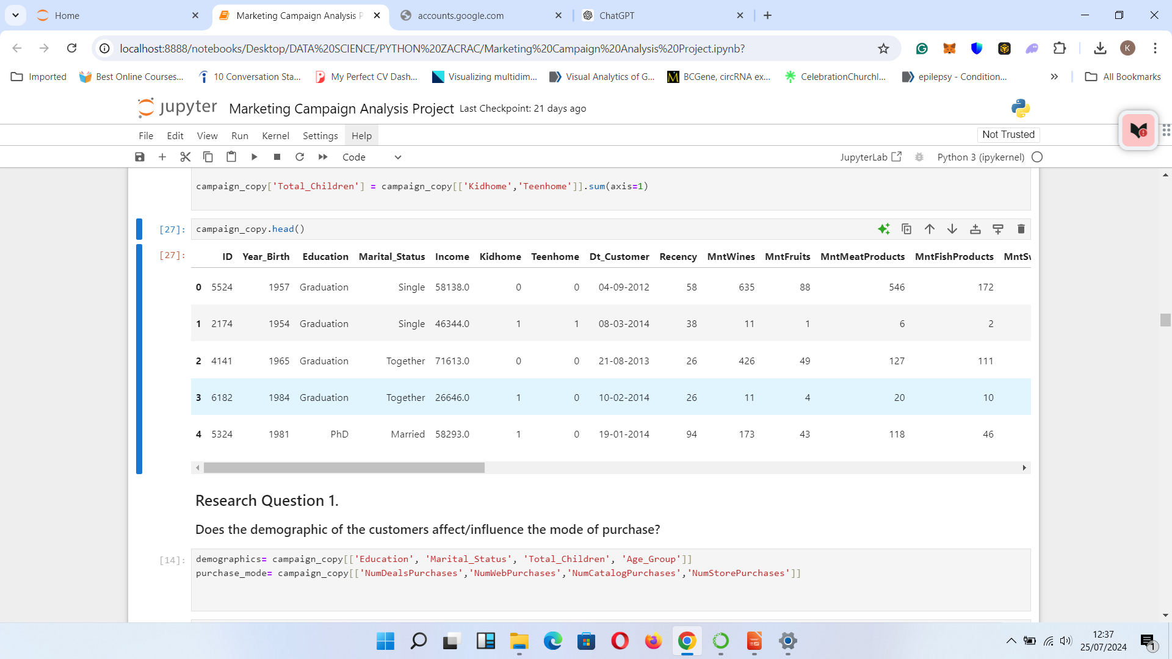
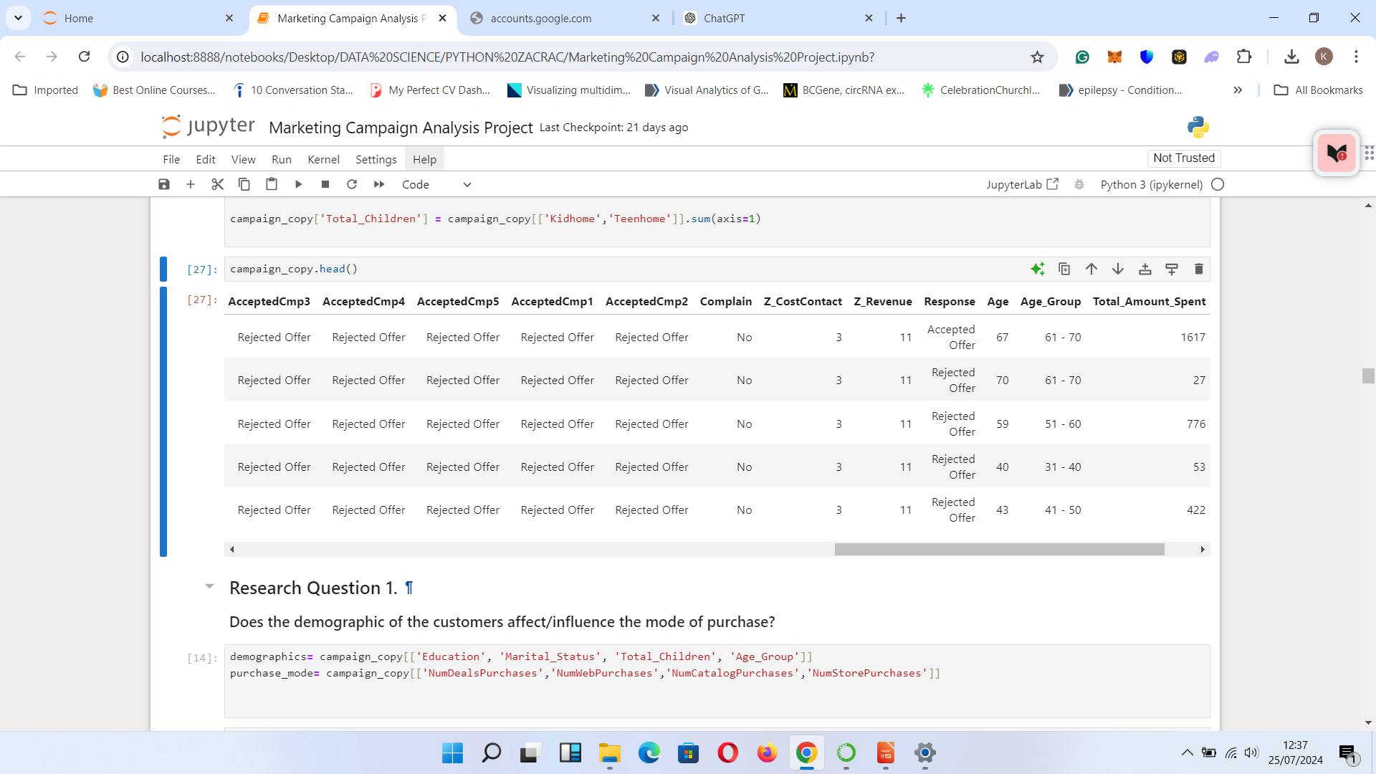

Slide 5
Problem Statement
Understanding customer behavior and predicting their responses to marketing offers by leveraging comprehensive analyses of demographics, purchasing behavior, and response history.

Slide 6
Methodology
Data Preprocessing: Handling missing values and data cleaning.
Exploratory Data Analysis (EDA): Identifying patterns and insights in the data.
Statistical Tests: Conducting hypothesis testing and correlation analysis to validate insights.
Modeling: Developing predictive models to identify key factors influencing customer behavior.

Slide 7
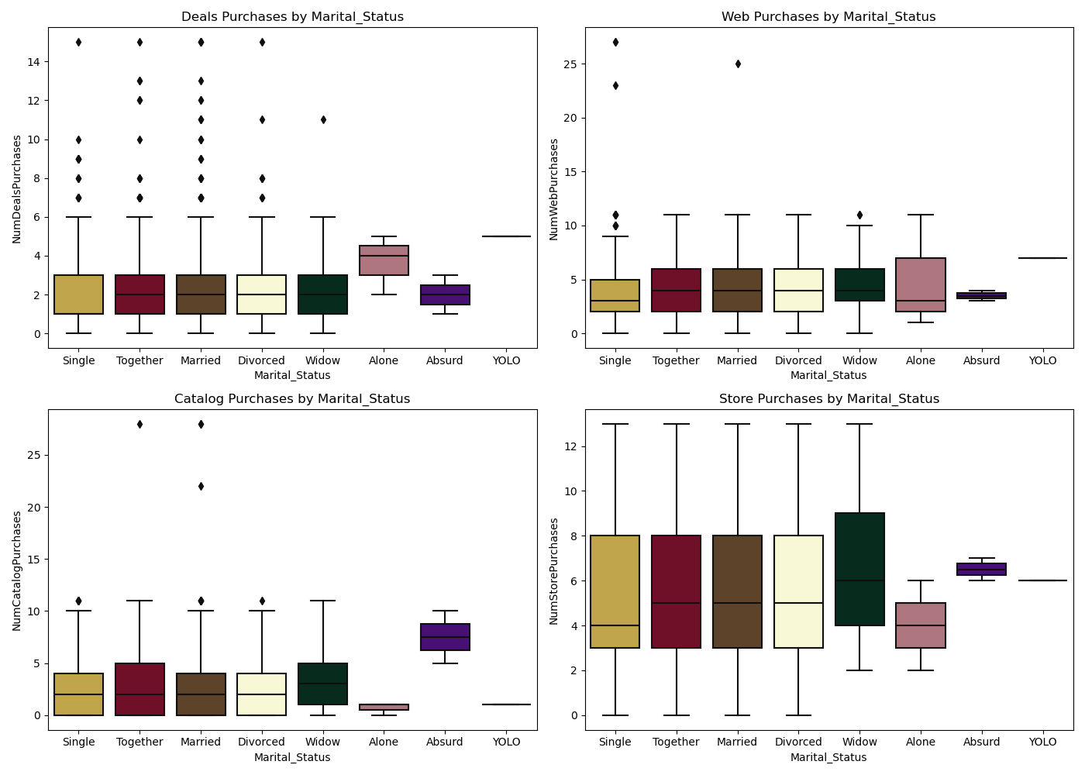
Key Findings: Demographics and Purchase Mode
Insights
.

Slide 8
Insights
Insight: No significant influence of marital status on the mode of purchase.
The boxplots reveal that the mode of purchase is not significantly influenced by the customers' marital status. Most customers prefer store purchases, while deal purchases have the least number of customers. This is supported by the p-value of 0.2201962988340332, which is greater than the confidence level of 0.05, leading to the failure to reject the null hypothesis.

Slide 9
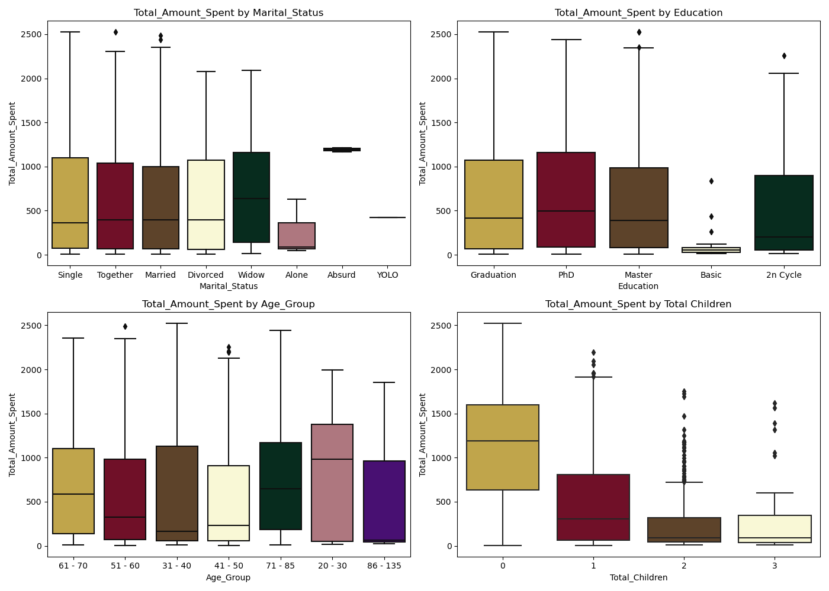
Key Findings: Amount Spent by Demographics
Insights
.

Slide 10
Insights
Insight: Higher spending by customers with no children and higher education levels.
Statistical Test: Significant influence of education on spending (F-statistic: 13.85, p-value: 3.66e-11).
Customers with no children tend to spend more. As the number of children increases, the total amount spent decreases. Additionally, customers within the age groups 31-40 and 71-85 tend to spend more. Singles and graduates are the highest spenders. The results indicate that education levels significantly affect spending, with higher education levels (Graduation, Master, PhD) associated with higher spending.

Slide 11
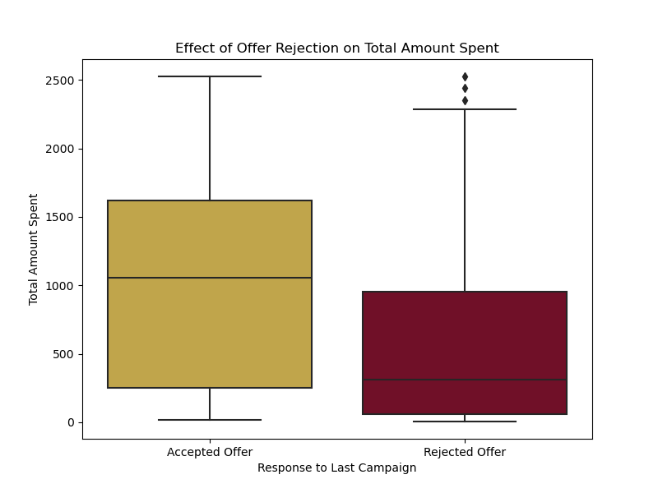
Key Findings: Campaign Offer Acceptance
Insights
.

Slide 12
Insights
Insight: Higher spending by customers who accepted the last offer.
Statistical Test: Significant association between acceptance and recent purchase behavior (p-value < 0.001).
Customers who accepted the last campaign offer spent more money compared to those who rejected the offer. This is supported by the p-value of 0.000000, which is less than the confidence value, leading to the rejection of the null hypothesis. This finding is corroborated by the boxplot analysis.

Slide 13
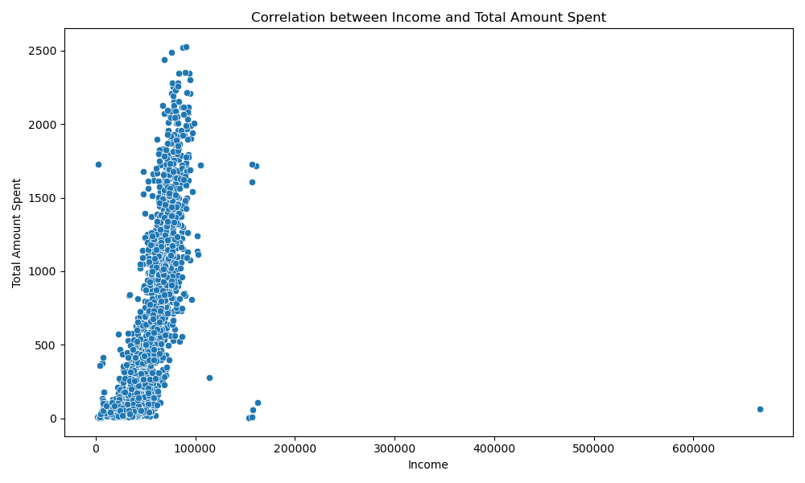
Key Findings: Income and Spending
Insights
.

Slide 14
Insights
Insight: Positive correlation between income and total amount spent (r = 0.68, p-value < 0.01).
The correlation test examines the relationship between customers' income and the total amount they spent in the store. The correlation coefficient (r = 0.68) indicates a moderately strong positive linear relationship. The p-value < 0.01 provides statistical evidence to reject the null hypothesis, suggesting that an increase in customers' income leads to an increase in total spending.

Slide 15
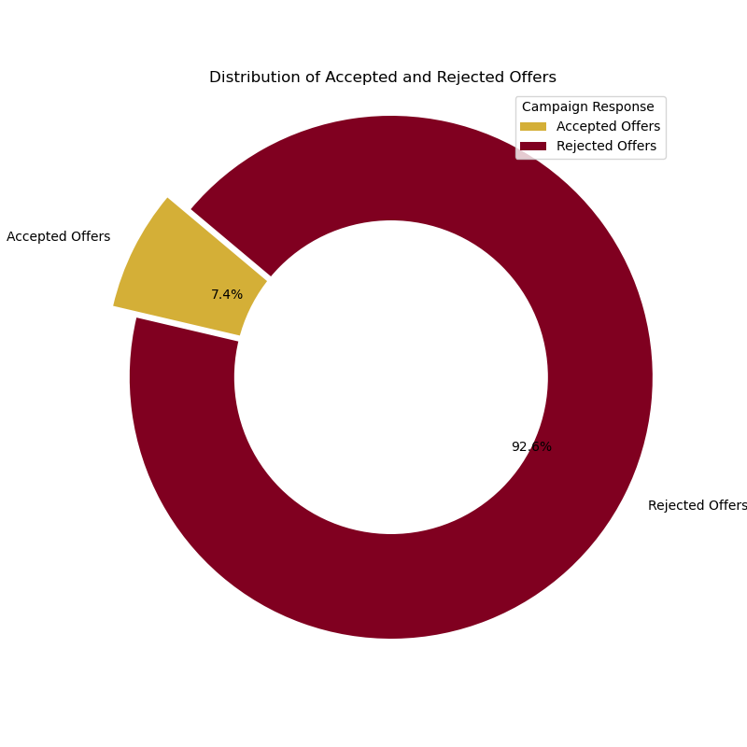
Key Findings: Campaign Offer Rejection
Insights
.

Slide 16
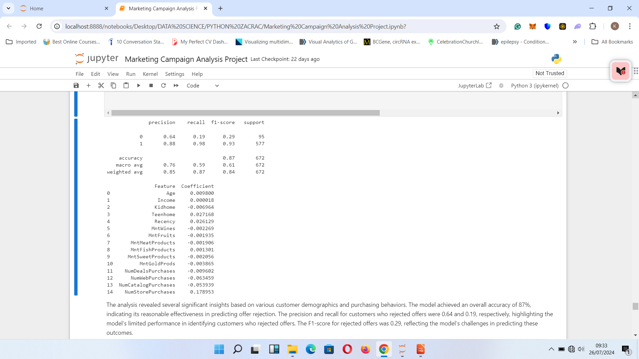
Key Findings: Campaign Offer Rejection
Insights
.

Slide 17
Insights
Insight: Older customers and those with higher recency values are more likely to reject offers.
Model Performance: Overall accuracy of 87%, with challenges in predicting offer rejection.
The model achieved an overall accuracy of 87%, indicating its reasonable effectiveness in predicting offer rejection. Key findings from the feature coefficients include that older customers and those with higher recency values are more likely to reject new offers. Spending habits also played a role; higher expenditures on certain products slightly decreased the likelihood of rejecting offers. Frequent deal, web, and catalog purchases were associated with a lower likelihood of rejection, while higher numbers of store purchases increased the likelihood of rejection.

Slide 18
Recommendations
Insights
Strategy Refinement: Align marketing strategies with customer behavior dynamics.
Channel Diversification: Utilize both physical and digital platforms to maximize outreach.
Targeted Campaigns: Focus on higher-educated and affluent demographics with personalized messaging and tailored incentives.

Slide 19
Recommendations: Campaign Optimization
Insights
Optimize Offer Acceptance: Tailor offers based on recent purchase behaviors to drive higher customer spending
Reduce Offer Rejection: Address demographic factors like age and spending habits to reduce rejection rates.
Enhanced Messaging: Ensure messaging resonates broadly across customer segments to improve campaign performance.

Slide 20
Conclusion
Implementing these strategies can elevate marketing effectiveness, deepen customer loyalty, and achieve sustained profitability.

Slide 21
THANK YOU

